Slide 1

Air Canvas with gesture control using OpenCV
by
Fardeen Hussain
Roll No. 214G1A3332
Hemanth Kumar. L
Roll No. 224G5A3305
Harish Chavan. M
Roll No. 214G1A3327
Dheeraj. C
Roll No. 214G1A3320
Under the guidance of
Dr. P. Chitralingappa _{M. Tech, Ph. D}
Associate Professor
Department of Computer Science and Engineering (AI & ML)
Srinivasa Ramanujan Institute of Technology
(Affiliated to JNTUA & Approved by AICTE) (Accredited by NAAC with ‘A’ Grade & Accredited by NBA (EEE, ECE & CSE)
Rotarypuram Village, B K Samudram Mandal, Ananthapuramu – 515701.
2024 - 2025

Slide 2
Contents
Abstract
Introduction
Objectives
Literature Survey
Existing System
Proposed System
Design
Implementation
Results
References

Slide 3
Abstract
This research introduces "Air Canvas," a virtual drawing tool controlled by hand gestures using OpenCV. It provides a contactless way to interact with a digital canvas by detecting and tracking hand movements in real time. Using computer vision techniques like color detection, contour analysis, and hand segmentation, the system maps gestures accurately while addressing challenges such as background noise and lighting variations. Key methods include skin-color thresholding for hand detection and motion tracking for smooth drawing, with gestures like fingertip detection for color selection. The Air Canvas highlights the potential of gesture-based interfaces for creative, educational, and assistive applications, with future work focusing on more gestures, improved algorithms, and hardware enhancements.

Slide 4
Introduction
What is Air Canvas ?
Definition: Air Canvas is an innovative virtual drawing tool that enables users to interact with a canvas using hand gestures, eliminating the need for physical tools like a mouse, stylus, or touchscreen.
Purpose: Designed to provide a touch-free, intuitive writing experience by harnessing the power of computer vision. Users can seamlessly translate their hand movements into writing in real time.
Relevance: Air Canvas highlights advancements in gesture recognition and computer vision technologies, demonstrating how technology can simplify and enhance human-computer interaction. It paves the way for accessible and inclusive tools, catering to diverse user needs, including individuals with physical limitations, while offering applications in creative, educational, and assistive domains.

Slide 5
Introduction
How it works?
Real-time Gesture Detection: The Air Canvas system uses a standard webcam to capture hand movements and detect gestures in real time. The hand movements are tracked and translated into drawing actions on a digital canvas, creating an immersive and intuitive user experience.
Key Techniques: The system leverages advanced computer vision techniques to ensure smooth and accurate gesture recognition. Color detection is used to identify specific features such as fingertips or hand regions, while contour analysis and hand segmentation enhance precision by isolating the hand from the background. Motion tracking algorithms ensure seamless and fluid drawing, mimicking the natural movement of a pen or brush.

Slide 6
Objectives
To develop an air canvas with more features.
Add more gestures for an intuitive experience.
Creating an fps tracker for understanding the relationship between the gestures and camera.
Using interpolate points method for smoother lines

Slide 7
Literature Survey
No | Title | Authors | Journal Name & Year | Methodology Adapted | Key Findings | Gaps
1. | A Pointing Gesture Based Egocentric Interaction System | Y. Huang, X. Liu, X. Zhang, and L. Jin | IEEE conference 2016 | Computer Vision Techniques | Using CNN and external tools for identifying objects | Smartglasses used as a webcam
2. | Air canvas application using Opencv and numpy | Saoji, S., Dua, N., Choudhary, A. K., & Phogat | IRJET,8(08), 2021 | Computer Vision Techniques | Implementing OpenCV methods and mediapipe for hand detection | Limited Tools and gestures
3. | Colour Detection using OpenCV | Nikhil Pandey, Aayushi Saxena, Amanya Verma | IJNTR,7(05), 2021 | Computer Vision Techniques | Implementing OpenCV methods for colour detection | No gaps, Used for reference

Slide 8
Literature Survey
No | Title | Authors | Journal Name & Year | Methodology Adapted | Key Findings | Gaps
4. | Air Scripting using OpenCV | Guluru Manoj Reddy, R Murali Dhar, Naveen Kumar, E Sathiyanarayanan | IJCRT,10(06), 2022 | Computer Vision Techniques | Implementing OpenCV methods and mediapipe for hand detection | Only index finger is used for drawing.
5. | Air canvas application using OpenCV and numpy | Saoji, S., Dua, N., Choudhary, A. K., & Phogat | IJFIAHM,(3), 2024 | Computer Vision Techniques | Implementing OpenCV methods and mediapipe for hand detection | Lack of line smoothness

Slide 9
Existing Systems
Smartphones direct contact with the screen, which can be restrictive and uncomfortable for long periods.
Graphic tablets need a larger workspace, making it less convenient for quick sketches or notes.
Interaction is typically via a mouse, stylus, or touch rather than natural gestures.
There are gesture-based studies available but they fail to integrate fingertips for tracking and depend on an external tool.
They also depend on the external hardware like kinetic sensors, LED light for identifying the tip.
The smoothness in lines and lack of enough gestures can be better.

Slide 10
Proposed System
Utilize a gesture based user interface to write, erase, draw or insert shapes onto the canvas.
Using multiple gestures for activities like isolating the drawing tip and clearing the board.
Select multiple colors according to your preference.
Operates seamlessly with a standard webcam, eliminating the need for specialized sensors or touchscreens.
Provides real-time feedback for a smooth and intuitive user experience.
Designed with simplicity in mind, offering an easy learning curve suitable for both casual and professional users.
Developed using OpenCV for advanced gesture recognition and Python for robust program logic.

Slide 11
Planning
Time Estimation:
Phase-1:
S.No | Activity | Duration
1 | Domain Selection | 1 week
2 | Literature Survey | 2 weeks
3 | Planning and Designing | 3 weeks

Slide 12
Planning
Time Estimation:
Phase-2:
S.No | Activity | Duration
1 | Research and Planning | 1 Week
2 | Setting up the environment | 2 weeks
3 | Implementing HandTracking | 2 weeks
4 | Implementing Drawing Functionality | 2 weeks
5 | Adding Color Selection and Clear Gestures | 1 week
6 | User Interface and Enhancements | 1 week
7 | Final touches and Deployment | 1 week

Slide 13
Planning
Hardware Requirements:
Processor: Dual-core CPU (e.g., Intel Core i3 or equivalent) minimum; Quad-core (e.g., Intel Core i5) recommended.
RAM: 4 GB minimum; 8 GB or more recommended.
Webcam: 720p minimum resolution; 1080p recommended for better accuracy.
Graphics: Integrated GPU minimum; Dedicated GPU (e.g., NVIDIA GTX 1050 or better) recommended for future enhancements.
Storage: 1 GB free space minimum; 10 GB free on SSD recommended.
Software Requirements:
OS: Windows 10 or later (64-bit recommended).
Python Version: Python 3.8 or later (3.10 recommended).
Python Libraries: numpy, opencv-python, opencv-contrib-python, mediapipe
IDE/Editor: Any Python IDE (e.g., PyCharm, VS Code, Jupyter Notebook).

Slide 14
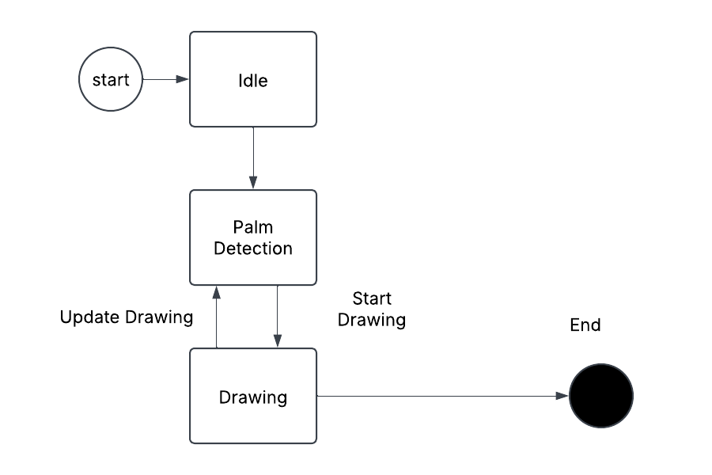
Design

Slide 15
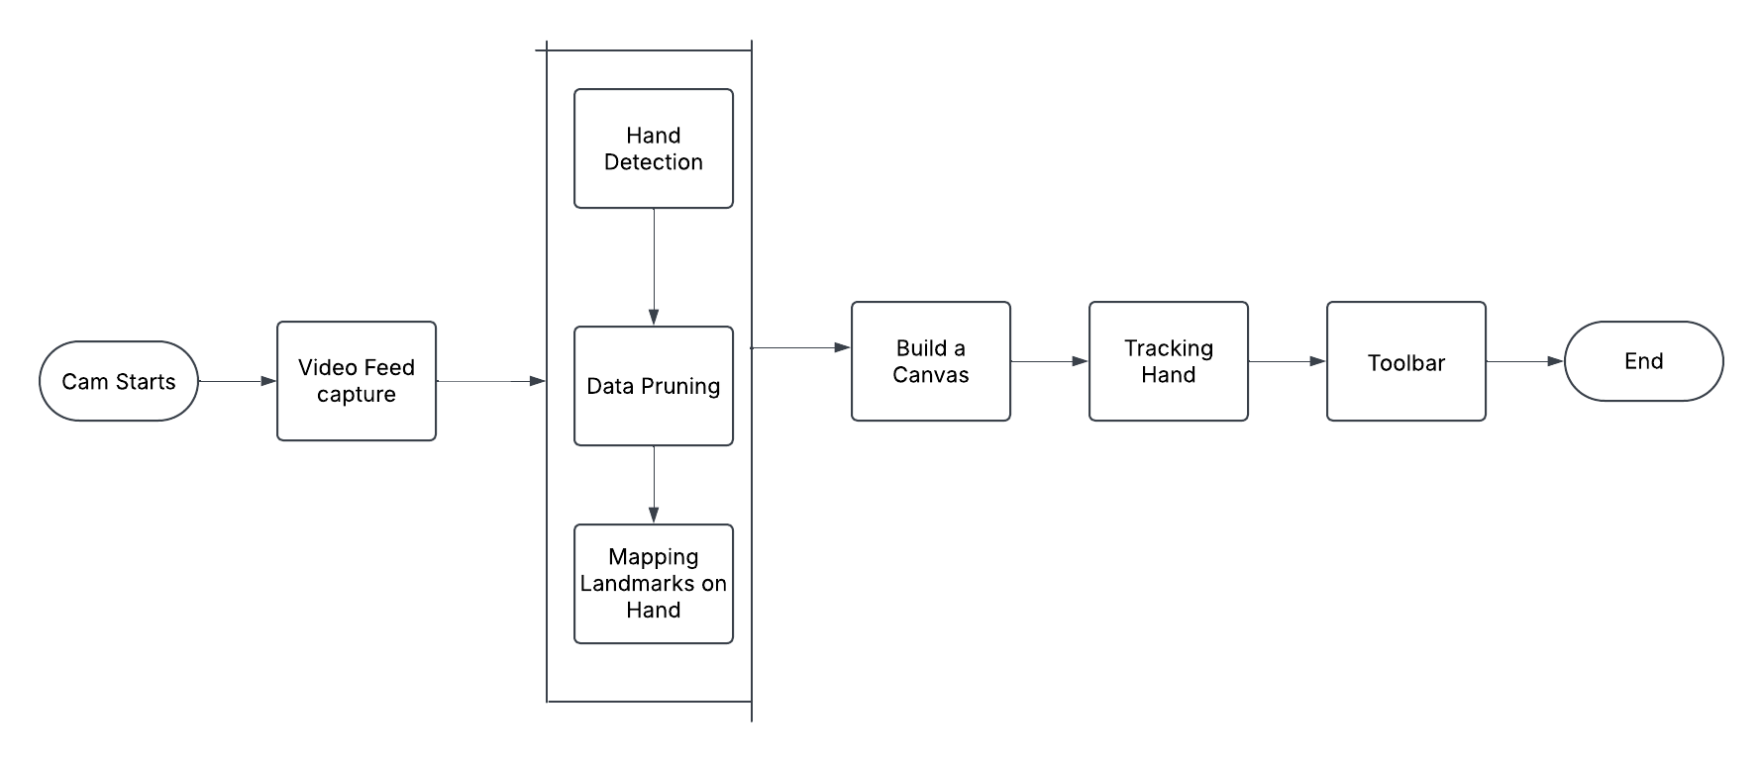
Design

Slide 16
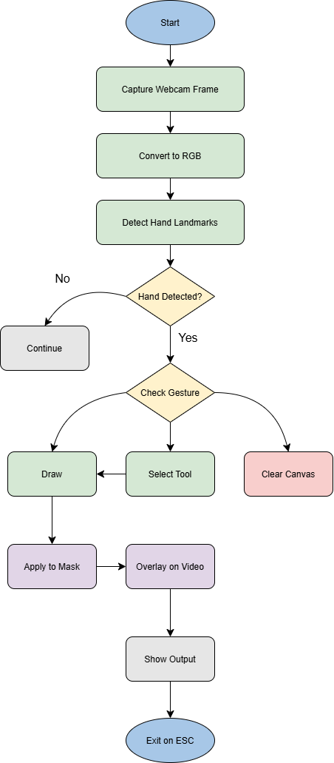
Design

Slide 17
Implementation
UI that shows the colors, tools and FPS
# Display current tool and selected color
cv2.putText(frm, f"Tool: {curr_tool}", (270 + ml, 30), cv2.FONT_HERSHEY_SIMPLEX, 1, (0, 0, 255), 2)
cv2.putText(frm, f"Color: {colors[color_index]}", (270 + ml, 60), cv2.FONT_HERSHEY_SIMPLEX, 0.7, colors[color_index], 2)
# Display FPS for performance monitoring
cv2.putText(frm, f"FPS: {fps}", (10, 30), cv2.FONT_HERSHEY_SIMPLEX, 1, (0, 255, 0), 2)

Slide 18
Implementation
Capturing the video frames, converting into RGB, and detecting hand landmarks.
cap = cv2.VideoCapture(0) # Capture frames from the webcam
while True:
_, frm = cap.read() # Read the current frame
frm = cv2.flip(frm, 1) # Flip for a mirror effect
rgb = cv2.cvtColor(frm, cv2.COLOR_BGR2RGB) # Convert BGR to RGB
op = hand_landmark.process(rgb) # Detect hand landmarks

Slide 19
Implementation
Gesture Detection
# Check if index finger is raised
def index_raised(yi, y9):
return (y9 - yi) > 40 # If index finger tip is higher than base, it's raised
# Check if fist is detected (including thumb)
def is_fist(landmarks):
# Landmarks for fingertips (4, 8, 12, 16, 20) and their corresponding knuckles (2, 6, 10, 14, 18)
fingertip_indices = [4, 8, 12, 16, 20]
knuckle_indices = [2, 6, 10, 14, 18]
threshold = 20 # Pixel threshold to determine if fingers are curled
for ft, kn in zip(fingertip_indices, knuckle_indices):
fingertip_y = landmarks[ft].y * 480
knuckle_y = landmarks[kn].y * 480
if abs(fingertip_y - knuckle_y) > threshold:
return False # Finger is extended, not a fist
return True # If all fingers are curled, it's a fist

Slide 20
Implementation
Tool Selection and Activation
def getTool(x):
if x < 50 + ml:
return "line"
elif x < 100 + ml:
return "rectangle"
elif x < 150 + ml:
return "draw"
elif x < 200 + ml:
return "circle"
else:
return "erase"
if x < max_x and y < max_y and x > ml:
if time_init:
ctime = time.time()
time_init = False
ptime = time.time()
cv2.circle(frm, (x, y), rad, (0, 255, 255), 2)
rad -= 1
if (ptime - ctime) > 0.8: # If hovering for 0.8s, select tool
curr_tool = getTool(x)
print("Your current tool set to:", curr_tool)
time_init = True
rad = 40

Slide 21
Implementation
Drawing Implementation(Freehand, line, rectangle, circle, eraser)
if curr_tool == "draw":
xi, yi = int(landmarks[12].x * 640), int(landmarks[12].y * 480)
y9 = int(landmarks[9].y * 480)
if index_raised(yi, y9):
if len(smooth_points) > 0:
for p in interpolate_points((prevx, prevy), (x, y)):
cv2.line(mask, (prevx, prevy), p, colors[color_index], thick)
prevx, prevy = p
else:
cv2.line(mask, (prevx, prevy), (x, y), colors[color_index], thick)
smooth_points.append((x, y))
else:
prevx, prevy = x, y
smooth_points = []
elif curr_tool == "line":
if index_raised(yi, y9):
if not var_inits:
xii, yii = x, y
var_inits = True
cv2.line(frm, (xii, yii), (x, y), colors[color_index], thick)
else:
if var_inits:
cv2.line(mask, (xii, yii), (x, y), colors[color_index], thick)
var_inits = False
elif curr_tool == "circle":
if index_raised(yi, y9):
if not var_inits:
xii, yii = x, y
var_inits = True
cv2.circle(frm, (xii, yii), int(((xii - x) ** 2 + (yii - y) ** 2) ** 0.5), colors[color_index], thick)
else:
if var_inits:
cv2.circle(mask, (xii, yii), int(((xii - x) ** 2 + (yii - y) ** 2) ** 0.5), colors[color_index], thick)
var_inits = False
elif curr_tool == "rectangle":
if index_raised(yi, y9):
if not var_inits:
xii, yii = x, y
var_inits = True
cv2.rectangle(frm, (xii, yii), (x, y), colors[color_index], thick)
else:
if var_inits:
cv2.rectangle(mask, (xii, yii), (x, y), colors[color_index], thick)
var_inits = False
elif curr_tool == "erase":
if index_raised(yi, y9):
cv2.circle(frm, (x, y), 30, (0, 0, 0), -1) # Erase from display
cv2.circle(mask, (x, y), 30, (255, 255, 255), -1) # Erase from canvas

Slide 22
Implementation
Applying Drawing to mask and Video Overlay
# Combine mask and frame
frm = cv2.bitwise_and(frm, mask)
# Display tools
frm[:max_y, ml:max_x] = cv2.addWeighted(tools, 0.7, frm[:max_y, ml:max_x], 0.3, 0)

Slide 23
Implementation
Exiting the Canvas
if cv2.waitKey(1) == 27: # Press 'Esc' to exit
cv2.destroyAllWindows()
cap.release()
break

Slide 24
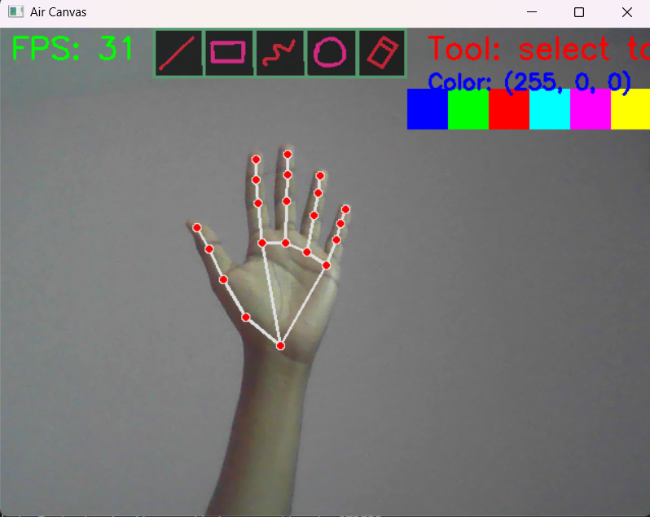
Results
User Interface

Slide 25
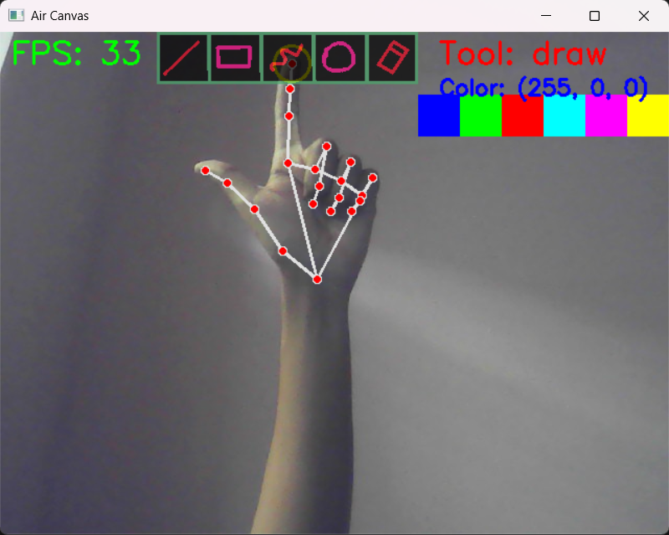
Results
Tool selection

Slide 26
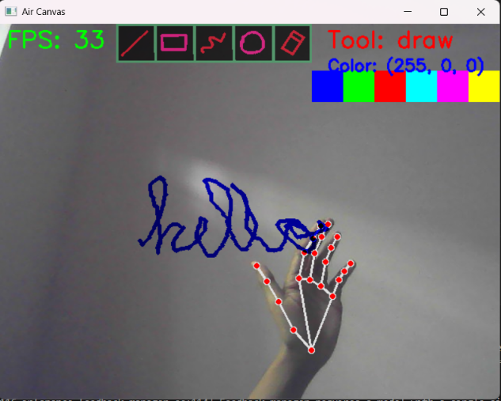
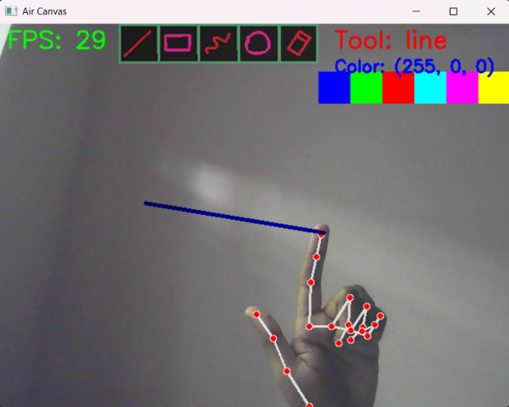
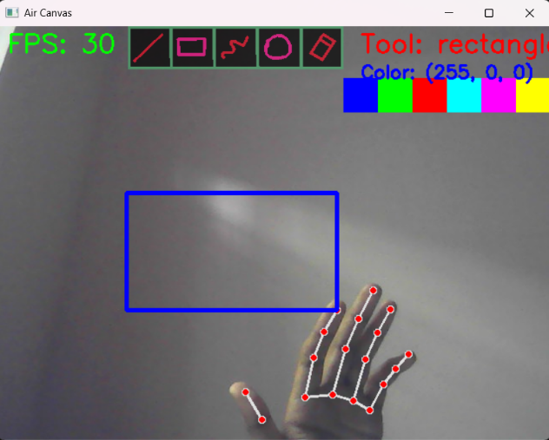
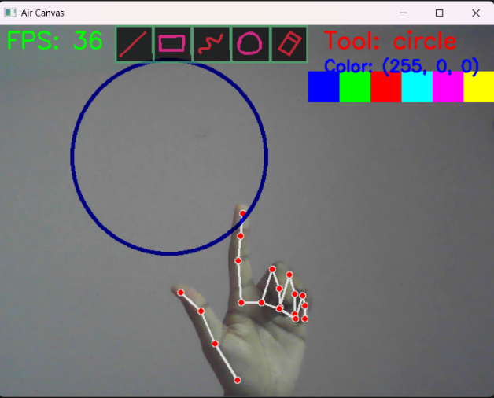
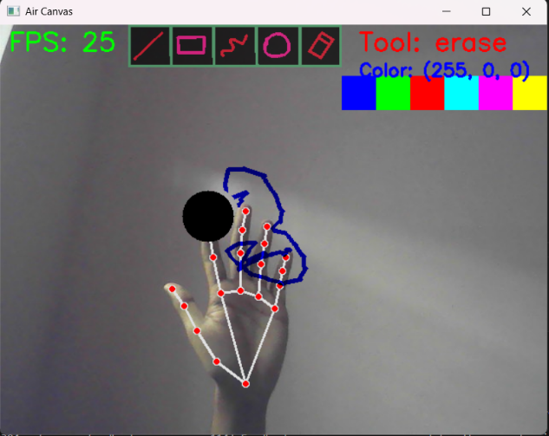
Results
Tool demonstration(freehand, line, rectangle, circle, eraser)

Slide 27
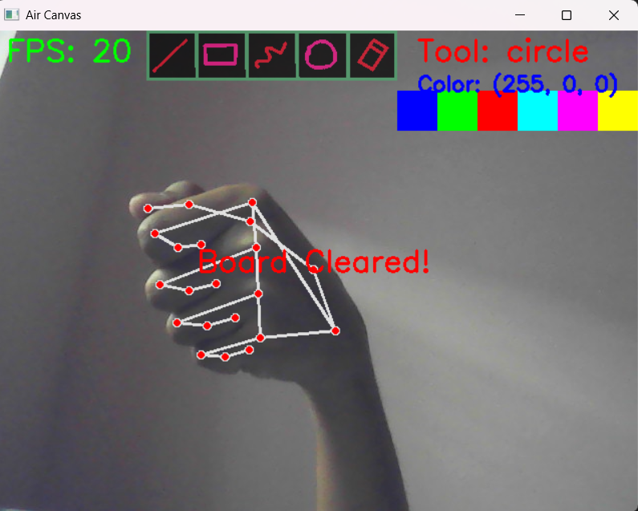
Results
Clearing the board

Slide 28
References
[1] Y. Huang, X. Liu, X. Zhang, and L. Jin, "A Pointing Gesture Based Egocentric Interaction System: Dataset, Approach, and Application," 2016 IEEE Conference on Computer Vision and Pattern Recognition Workshops (CVPRW), Las Vegas, NV, pp. 370 377, 2016.
[2] Saoji, S., Dua, N., Choudhary, A. K., & Phogat, B. Air canvas application using Opencv and numpy in python.IRJET,8(08), 2021.
[3] Nikhil Pandey, Aayushi Saxena, Amanya Verma “COLOUR DETECTION USING OPENCV”, International Journal of New Technology and Research (IJNTR) ISSN: 2454-4116, Volume-7, Issue 5, May 2021.
[4] Guluru Manoj Reddy, R Murali Dhar, Naveen Kumar, E Sathiyanarayanan "AIR SCRIPTING USING OPENCV“, (IJCRT) Volume 10, Issue 6 June 2022.
[5] Pratik Nikhar, Lowlesh Yadav, Neehal Jiwane, “AIR CANVAS APPLICATION USING OPENCV AND NUMPY IN PYTHON”, (IJFIAHM), Volume 3, Issue , 2024.

Slide 29
Any Queries?

Slide 30
Thank You!!!

